Slide 1
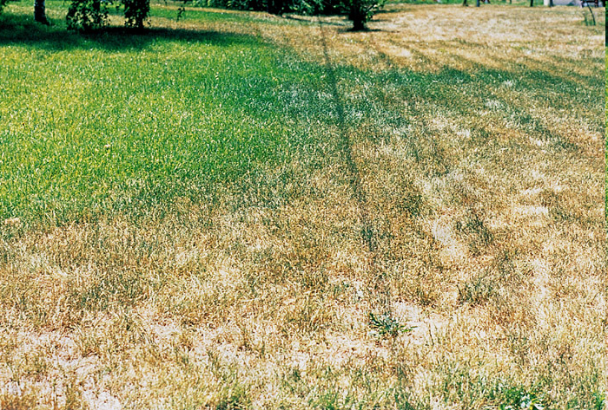
Lawn Care During and After a Drought
Kurt Froelich
NDSU Extension- Stark/Billings County

Slide 2
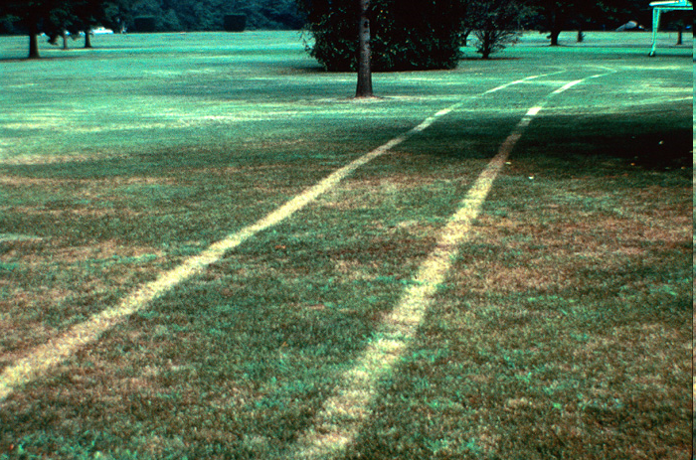
Leaf blades and crowns killed where equipment was operated on dry, dormant grass.
Symptoms appear when growth resumes after rain or watering.

Slide 3
Potassium (K⁺) Fertilization to Prevent Drought Stress
Potassium (K⁺) is directly involved in stomatal aperture.
-The stomates allow plants to exchange gasses.
-When open, oxygen (O₂) is released to the atmosphere and carbon dioxide (CO₂) is absorbed.
by the plant and converted into sugar (energy) during the photosynthetic process.
Potassium plays a role in: photosynthesis, carbohydrate synthesis, protein synthesis,
enzymatic reactions, and transpiration.
Carbohydrate production is reduced when K⁺ is deficient.
Influences: rooting; disease resistance; and drought, heat, cold, and wear tolerance.

Slide 4
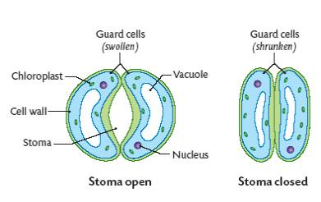
http://leavingbio.net/TRANSPORT%20OF%20MATERIALS%20IN%20A%20FLOWERING%20PLANT_files/image011.jpg
Potassium regulates stomatal aperture
When stomates need to open, potassium (K⁺ (a salt)) is absorbed by the guard cells.
Water flows to the K⁺ then the guard cells swell and the stomates open.
When the leaf has absorbed enough CO₂, finished gas exchange or transpirational pull,
the K⁺ ions leave the guard cells. The cells dehydrate and the stomate closes.

Slide 5
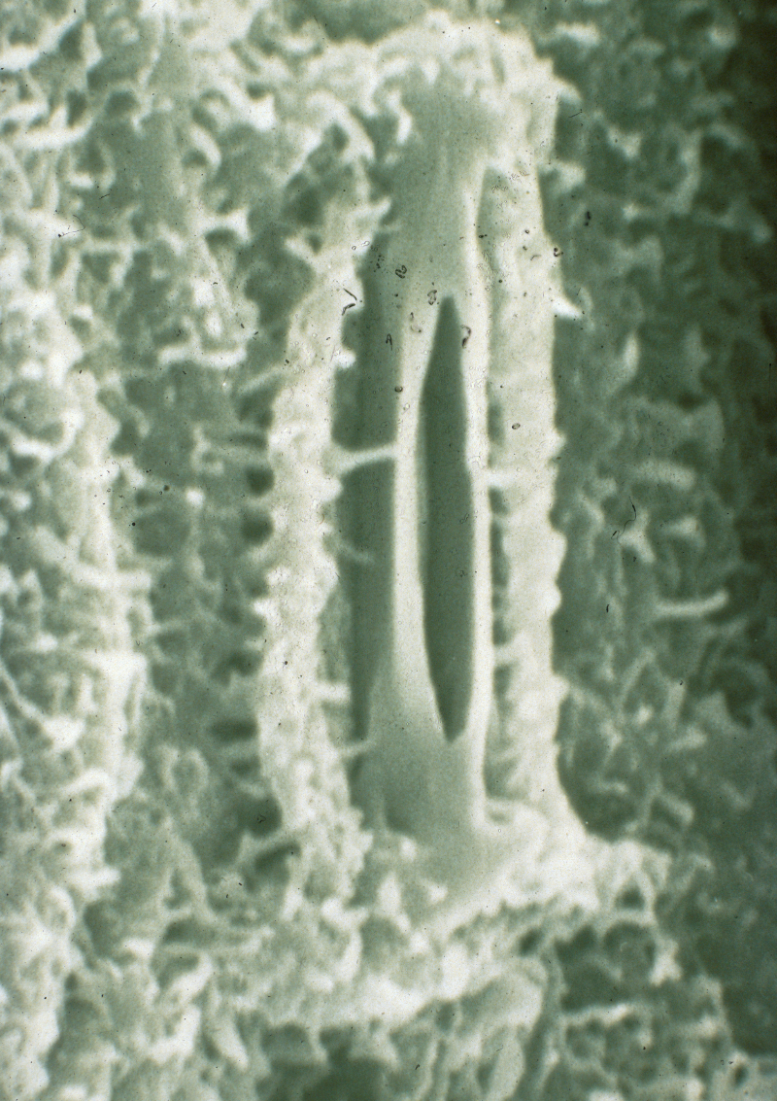
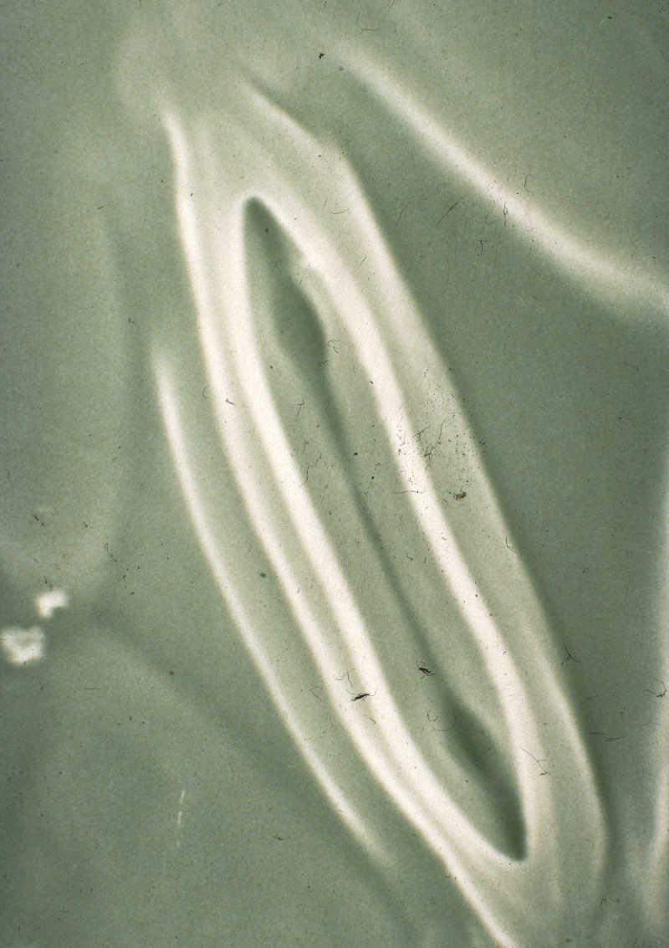
Well watered 8 days of drying
St. Augustine Stoma

Slide 6
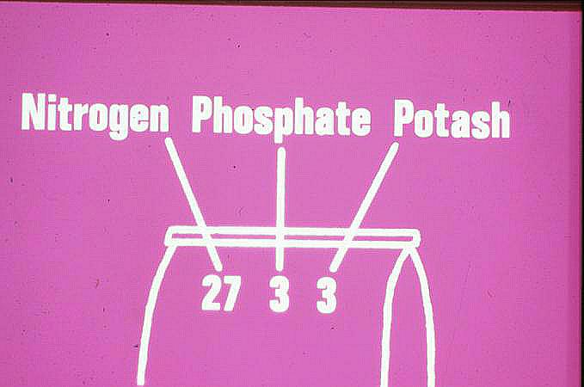
Nitrogen
Phosphorus
Potassium

Slide 7
Potassium fertilizer sources
Muriate of potash, 0-0-60
Sulfate of potash, 0-0-50
Potassium nitrate, 13-0-44
Fertilizer containers always report K content as % K₂O, which is only 83% actual K⁺.

Slide 8
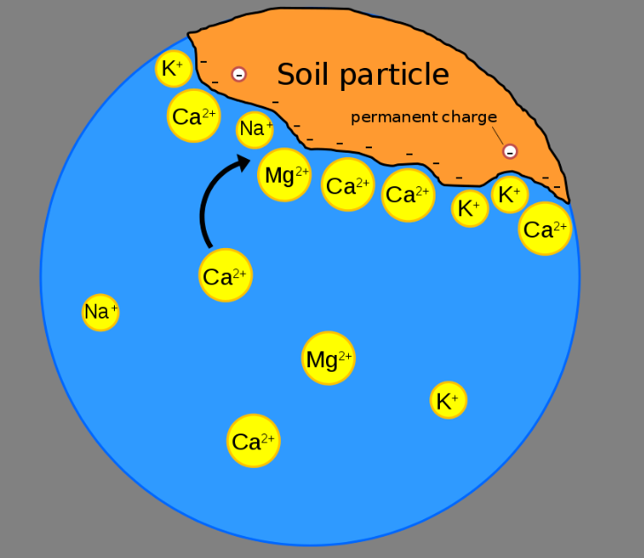
Spoon feeding – Applying a light application of a nutrient on a regular basis.
Overapplication of K⁺ can lower the cation exchange capacity (CEC) of the soil by binding up
the active sites on the soil particles, which will allow other nutrients to quickly leach through
the soil.
Spoon feed potassium to your lawn to avoid leaching of other valuable cations, such as
magnesium, zinc and copper through the soil.
Apply approx. .1 lb. K⁺/1000 sq. ft. every 2-4 weeks before and during a drought to maintain
drought tolerance.

Slide 9
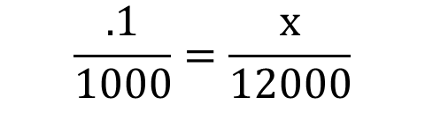
Fertilizer Calculations
How much 0-0-60 fertilizer will it take to apply .1 lb. K⁺/1000 sq. ft. to 12,000 sq. ft.?
$$\frac{.1}{1000}=\frac{x}{12000}$$
X = 1.2 lbs. K
1.2 ÷ .60 = 2 lbs. of 0-0-60 are required to apply .1 lb. K⁺ to 12,000 sq. ft.
Since K⁺ is packaged as K₂O, we must account for the oxygen molecules to apply the
correct amount of K⁺.
2 ÷ .83 = 2.4 lbs. of 0-0-60 are actually needed.

Slide 10
“Deep and Infrequent” Irrigation
Wetting the soil to the maximum depth of most of the root system, and waiting until the point when wilt is first observed before watering again (usually one week).

Slide 11
Irrigation Management
Benefits of deep, infrequent irrigation:
Deeper and more extensive rooting.
A plant better acclimated to oncoming stress.

Slide 12
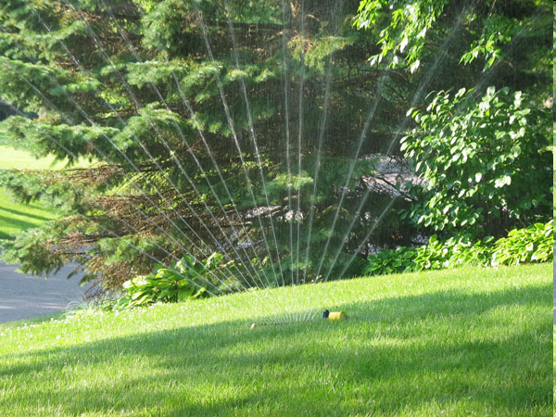
Irrigation Management
Look for darker “hot spots.”
Often have a purplish tinge.
Best to allow turf to undergo
some stress early in the
season. Makes turf more
drought resistant.
Attempt to apply ¾ to 1 inch of
water each time you irrigate.
www.extension.umn.edu/.../LawnWatering-lg.jpg
Notes:
12

Slide 13
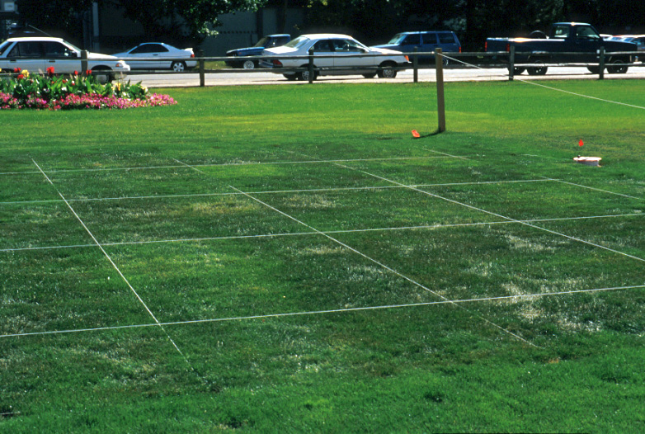
Wilted turf bluish-gray in color and “footprints” evident.

Slide 14
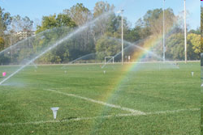
How to Tell if You Watered Enough
Use catch cans
Use a screwdriver; moisture down 6-8 inches
http://www.8daysaweek.net/whydoanirrigationaudit.html
Notes:
14

Slide 15
Irrigation Management
Proper Watering
Shallow, Frequent
Deep, Infrequent
Notes:
15

Slide 16
Irrigation Management
After Drying for Infrequent
Shallow, Frequent
Deep, Infrequent
Notes:
16

Slide 17
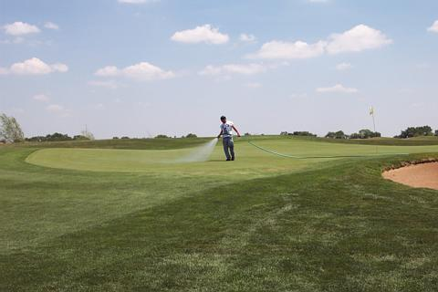
Irrigation Management
Syringing - Very light application of water.

Slide 18
Irrigation Management
Syringing is done to:
Reduce leaf temperature by evaporative cooling (latent heat of vaporization).
More effective when relative humidity is low.
It is not the same as hand watering!
Usually done at midday, but more than one may be needed per day.

Slide 19
Irrigation Management
If your lawn is already dormant, just apply ¼ - ½ inch of water every 2-4 weeks to keep the
crown tissue hydrated.
Breaking dormancy actually drains reserves within the plant, and if conditions remain dry
and the weather is hot, the plant is not likely to replace those reserves.

Slide 20
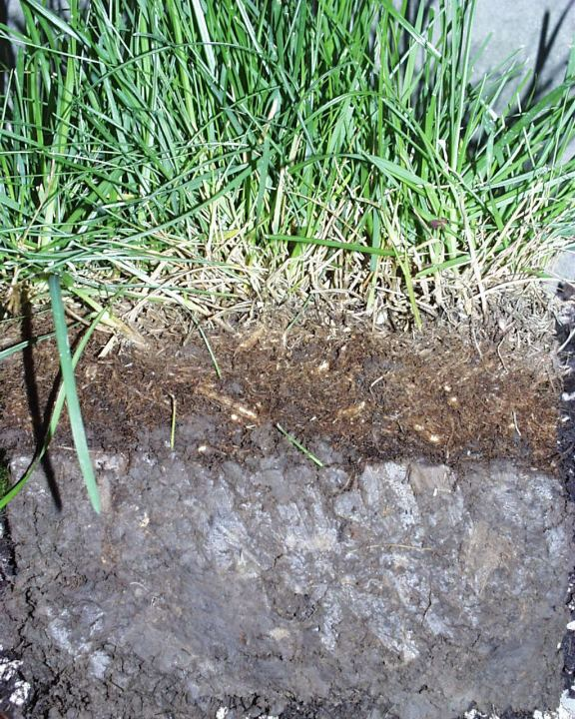
Thatch and Turf Cultivation
Thatch: Accumulation of dead and living material above the soil surface, below the turf canopy.
Returned grass clippings do not cause thatch accumulation as long as you do not remove more
than 1/3 of the grass blade when you mow.

Slide 21
Thatch
Problems with thatch:
Turf becomes puffy (scalping or rippled appearance after mowing).
Roots and crowns grow in it.
Difficult to wet.
Harbors insects and pathogens.
Notes:
21

Slide 22
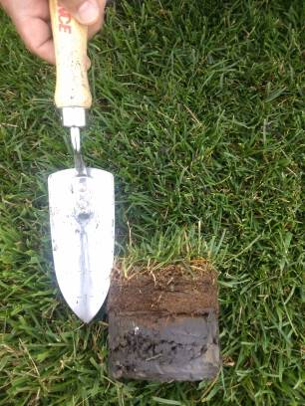
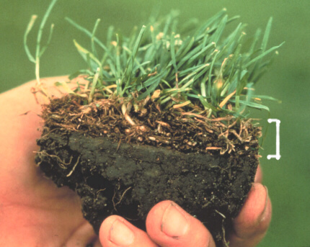
Beneficial
Detrimental
A half inch of thatch or less is considered beneficial
Conserves soil moisture
Provides cushion to the soil surface
Good media for beneficial macro- and microorganisms
Moderates summer heat stress
Filters water before it reaches the water table
Reduces the movement of pesticides into groundwater
Notes:
22

Slide 23
Turf Cultivation Equipment to Remove Thatch
Power rake
Core aerifier
Do not use any turf cultivation machines if the air temperature is above 75º.
Be sure that there is at least one month of growing weather left after cultivating so the turf has time to heal before winter arrives.

Slide 24
Mowing
Raise the mowing height by ¼ - 1/2 inch during a drought to increase:
Carbohydrate synthesis.
Growth rate and total root production.
Growth of lateral stems.
Overall turfgrass vigor.

Slide 25
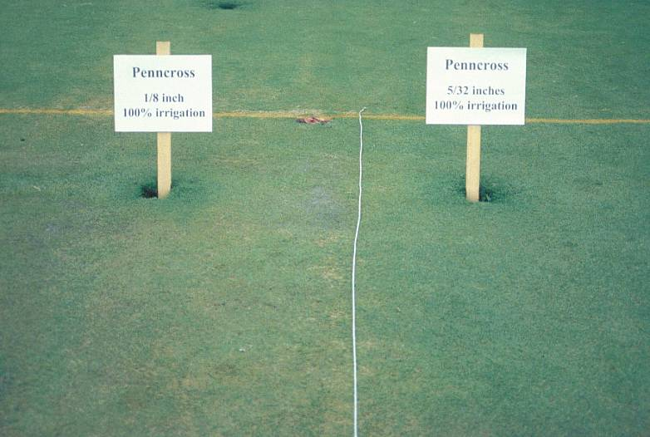

Slide 26
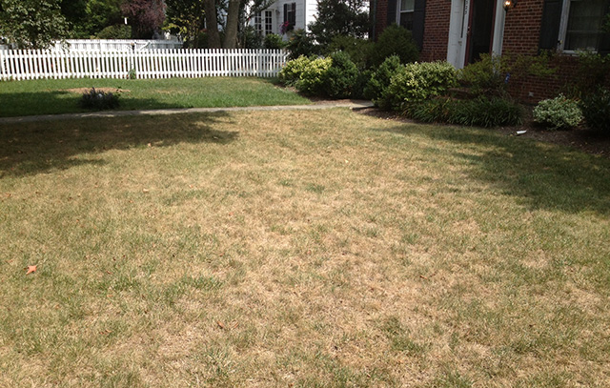
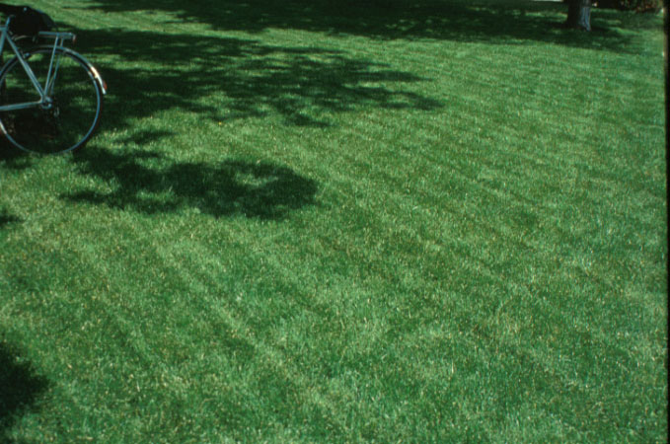
https://www.ecogreen.ca/how-do-i-save-my-lawn-in-a-drought/
After the drought subsides, continue to use proper cultural practices to maintain a vigorous lawn.

