Slide 1
Growing a Great Lawn and Saving Money
Tom Kalb, Ph.D.
North Dakota State University
tom.kalb@ndsu.edu

Slide 2
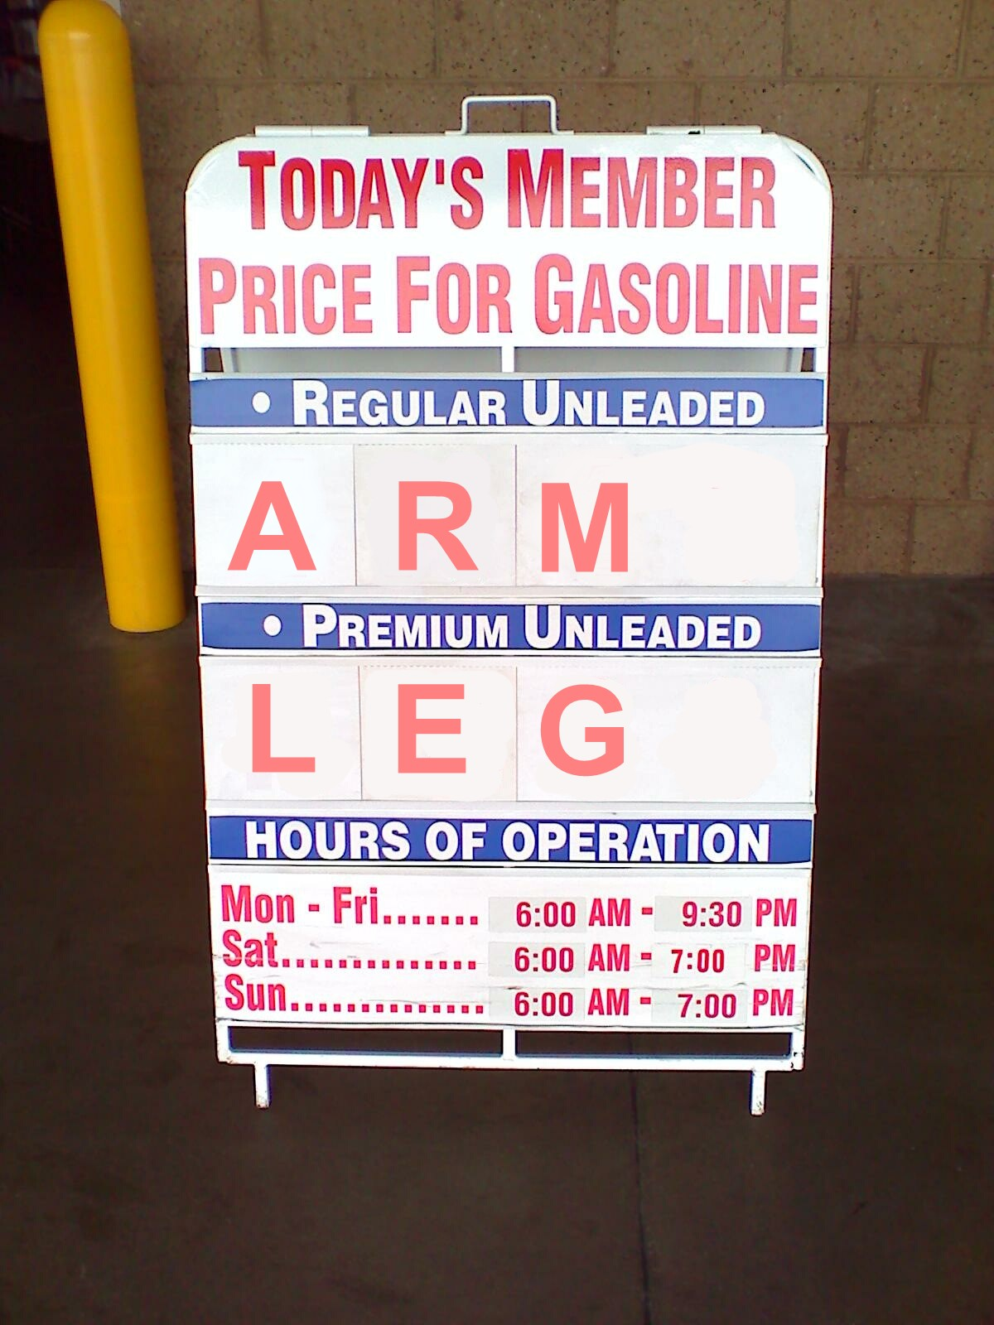
AgentAkit

Slide 3
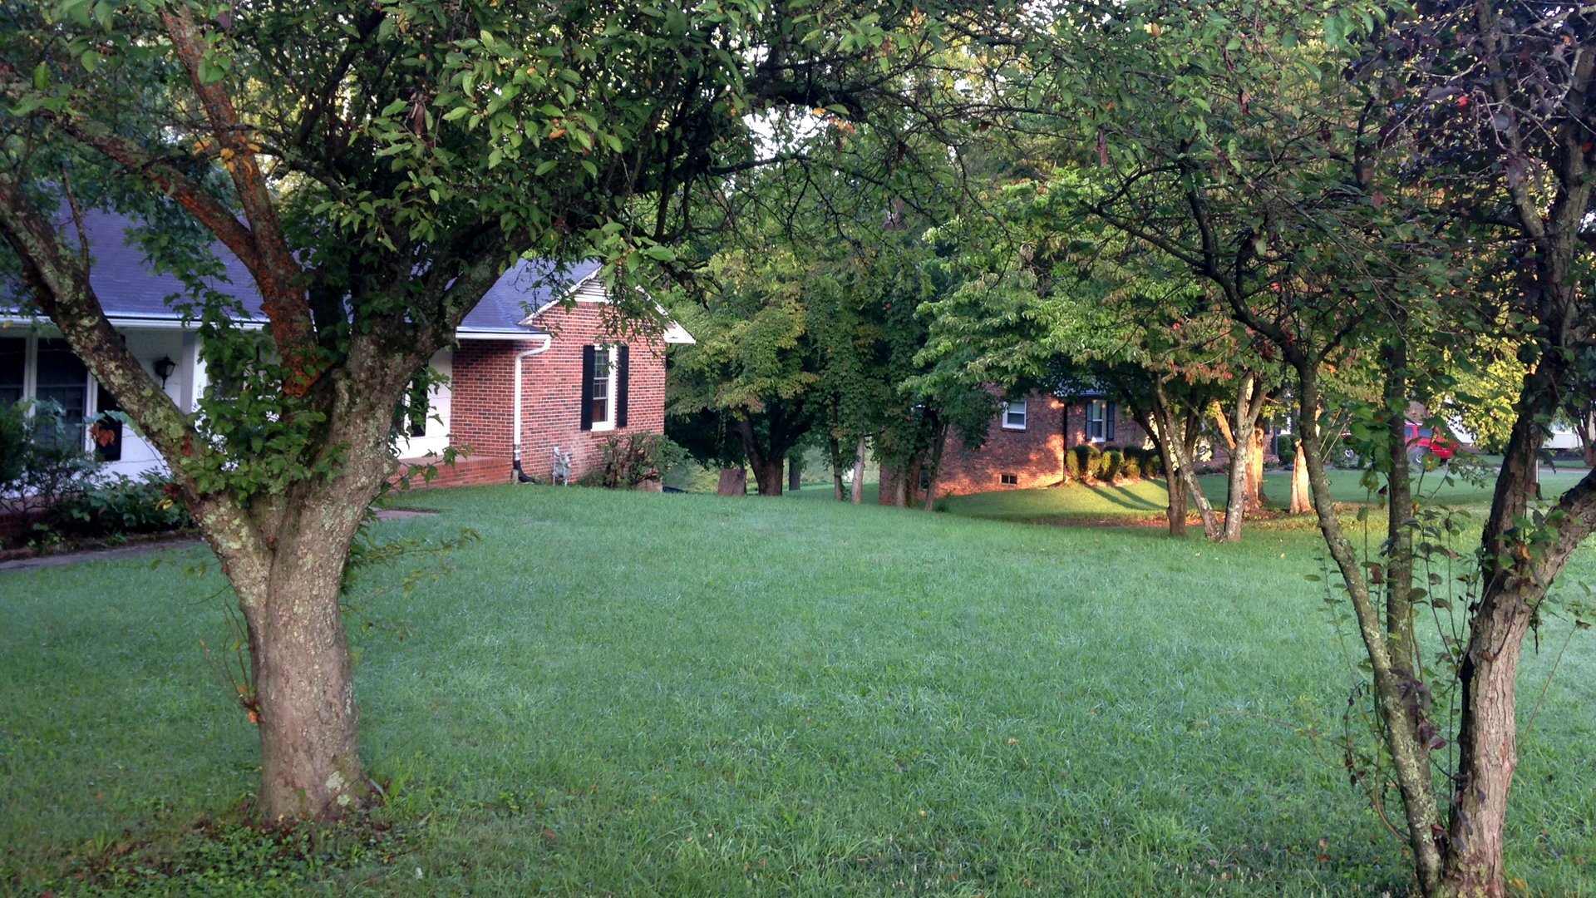
R. Ella
Notes:
Every lawn is different. Lawn care is subjective. Some people like caring for a lawn and some do not. All I can provide today are guidelines. It’s your option how you use the information.

Slide 4
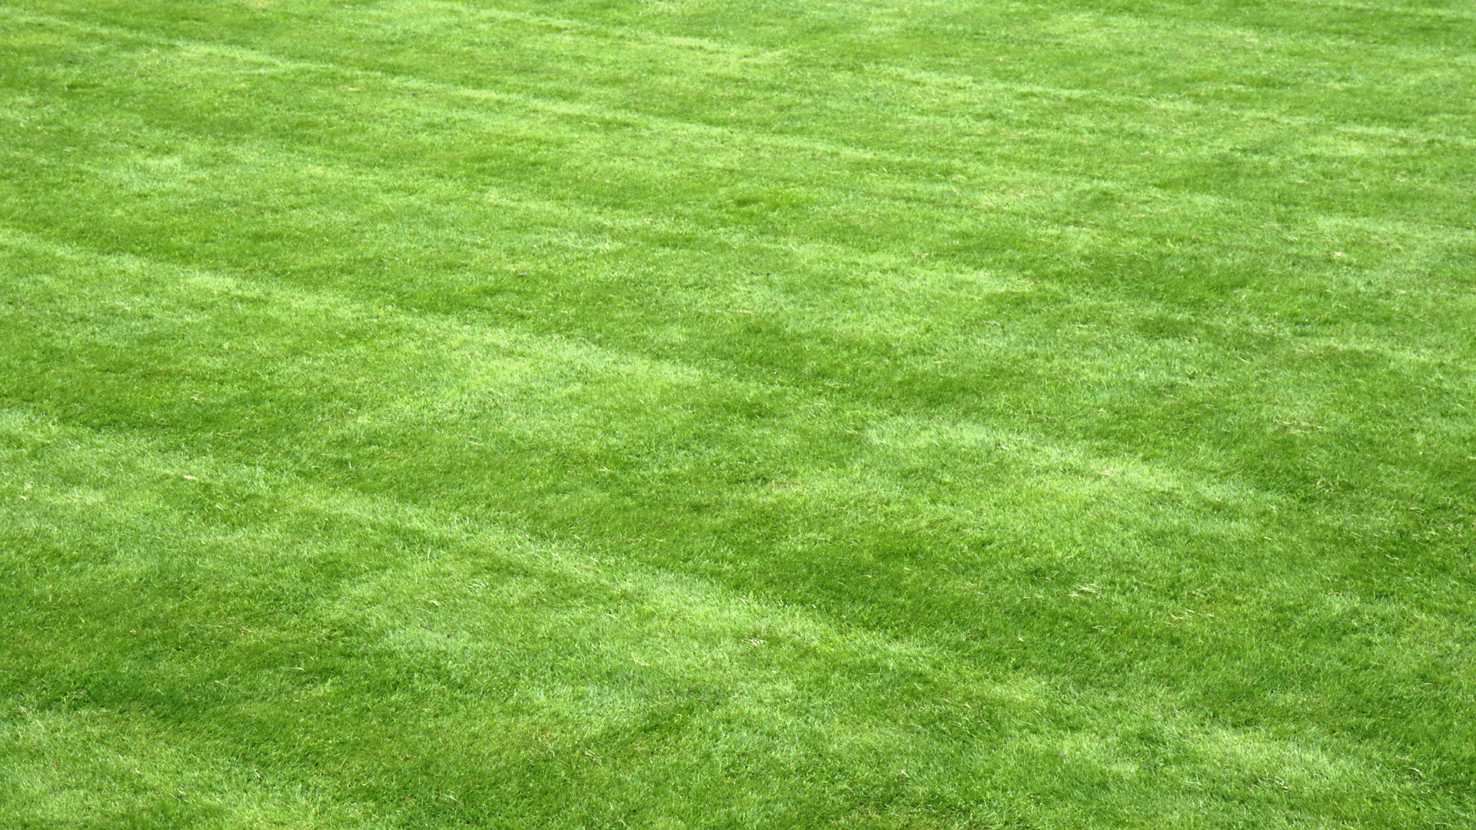
graham
Notes:
Is this the ideal lawn?

Slide 5


Slide 6
Lawn
Establishment/Renovation
August 15 to September 15
Soil is warm and seeds will germinate quickly
Less concern over emerging weeds
Temperatures begin to cool off

Slide 7
Seed or Sod?
Advantages of Seeding
Less expensive
More grass species available
Develops a stronger root system

Slide 8
Popular Grass Species
Kentucky Bluegrass
  Sunny areas; cold-hardy; goes dormant in drought; wear-tolerant
Fine Fescues (Creeping Red, Chewings Red, Hard)
  Tolerates shade and salt; low-maintenance
Perennial Ryegrass
  Emerges fast; less hardy; less wear-tolerant

Slide 9
Alternative Grass Species
Turf-type Tall Fescue
Crested Wheatgrass
Buffalograss

Slide 10
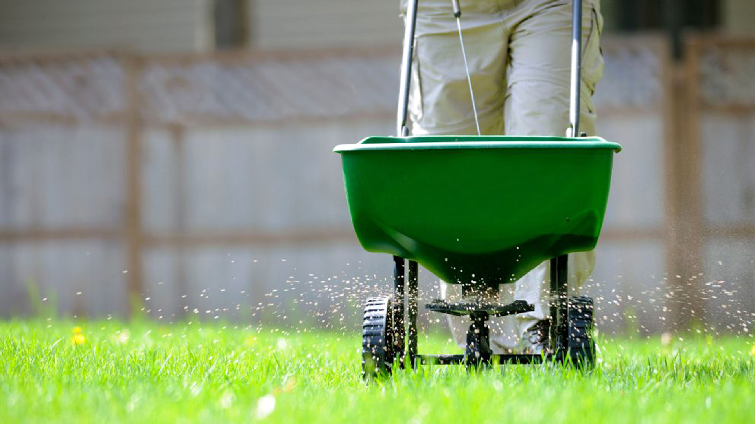
Fertilizing

Slide 11
When to Fertilize?
Early Spring
Memorial Day
Fourth of July
Labor Day – best time
October
Notes:
Early spring is not recommended. Grasses want to grow roots then. If you fertilize in early spring, the grass will stop producing roots and start producing shoots. This is not good in the long-term.

Slide 12
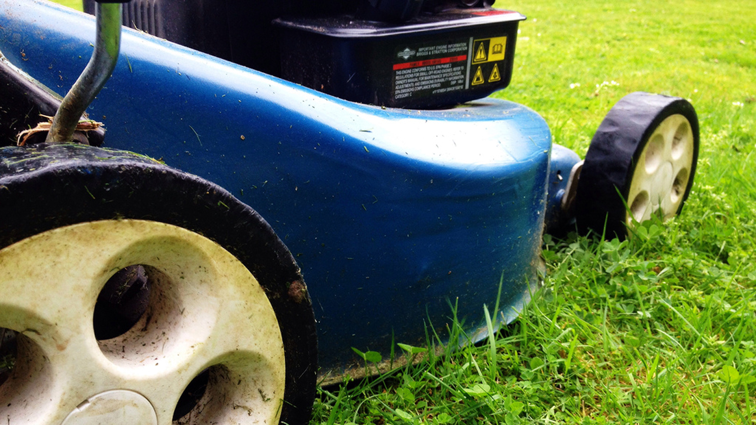
Mowing
Michael McGimpsey

Slide 13
Let Clippings Fall
  Clippings recycle nutrients
  Free fertilizer!
  Saves time
  Clippings shade the soil, keeping it cool

Slide 14
Mow Tall
  Tall turf smothers weeds
  Tall turf develops deeper roots
  Tall turf shades the soil, keeping it cool

Slide 15
Watering Lawns
Irrigate in the morning
Avoid windy days and hot afternoons
One inch per week
Water deeply, not frequently

Slide 16
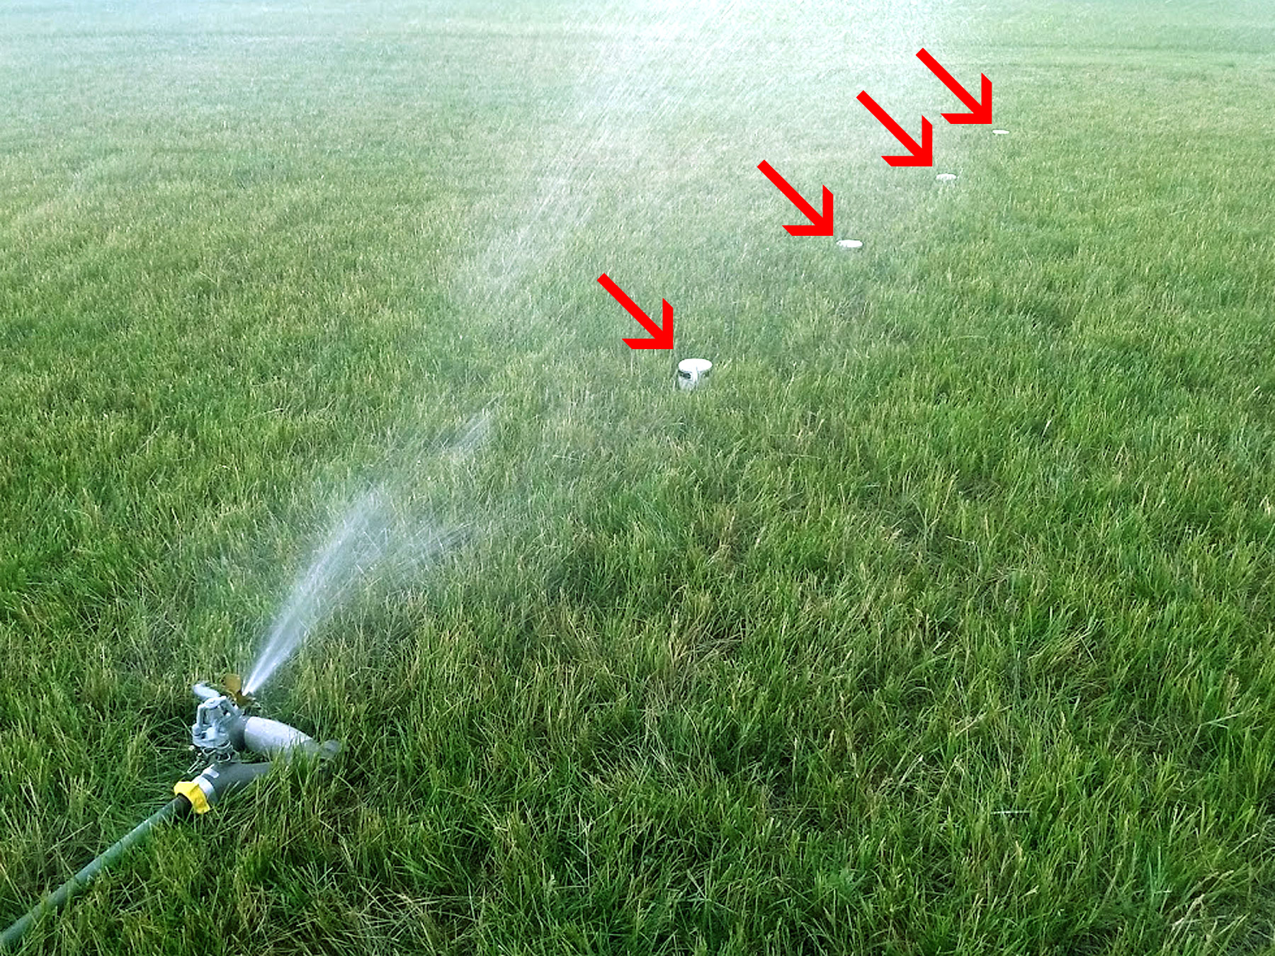

Slide 17
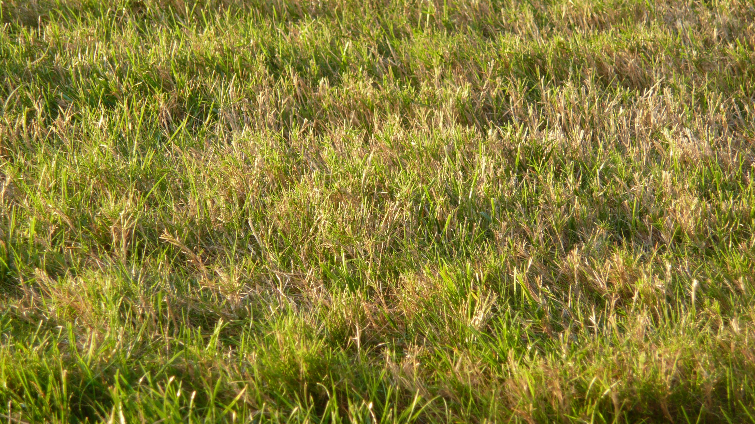
Jeff Youngstrom

Slide 18
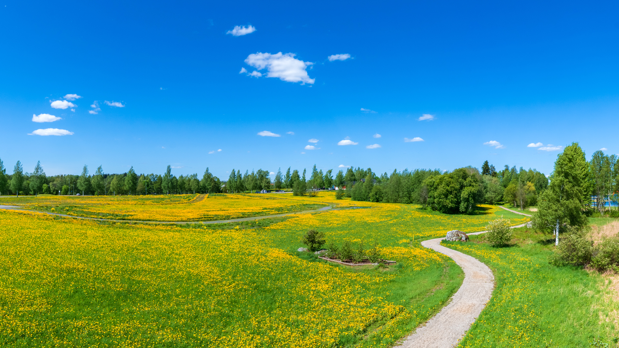
Aki Mykkänen
Notes:
Golden dandelion

Slide 19
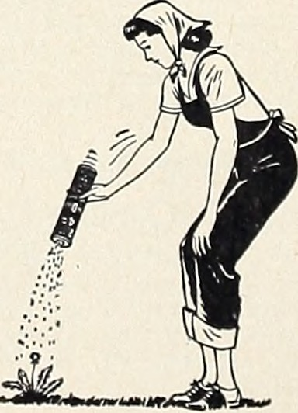
Internet Archive Book Image

Slide 20
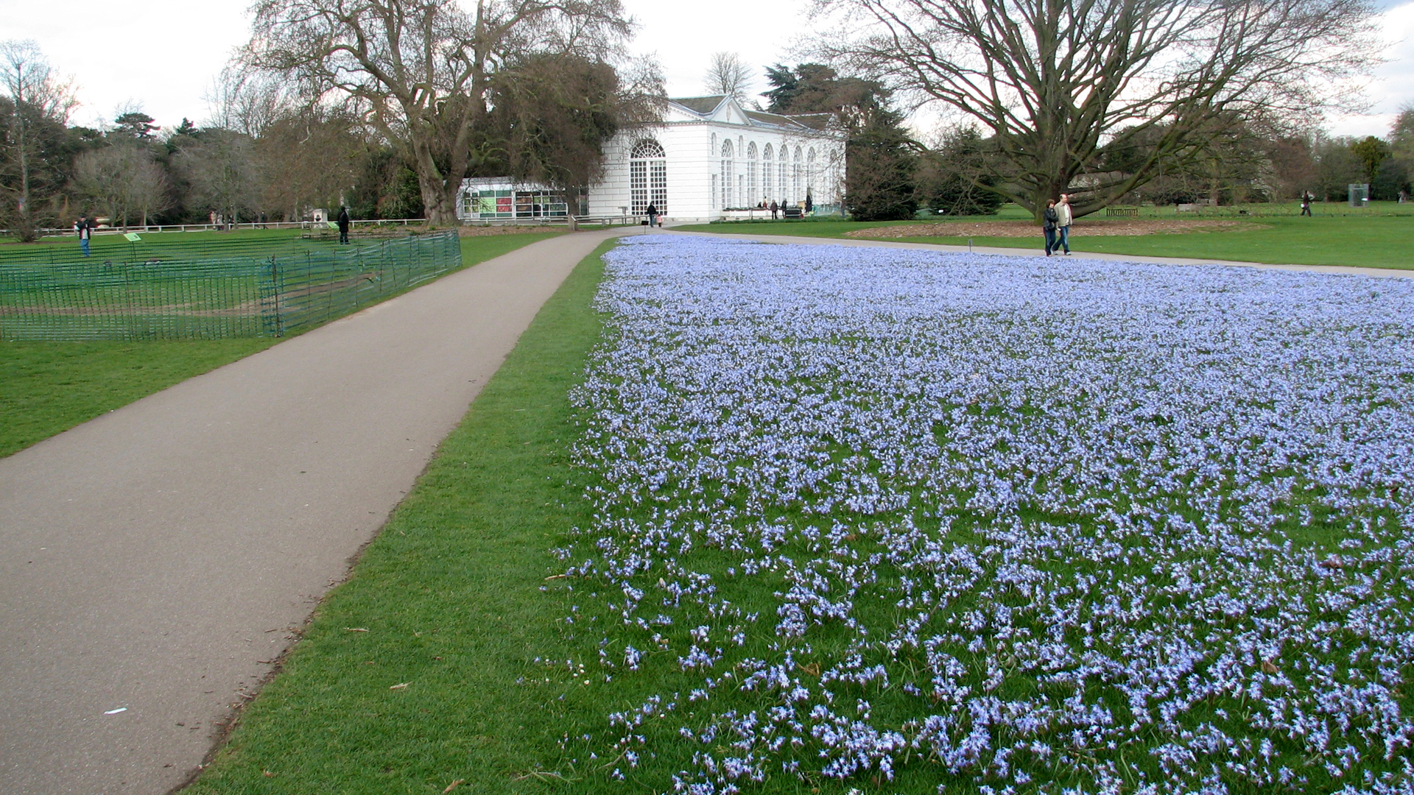
Tim
Notes:
Isn’t this more beautiful? What’s wrong with having some flowers in a lawn?

Slide 21
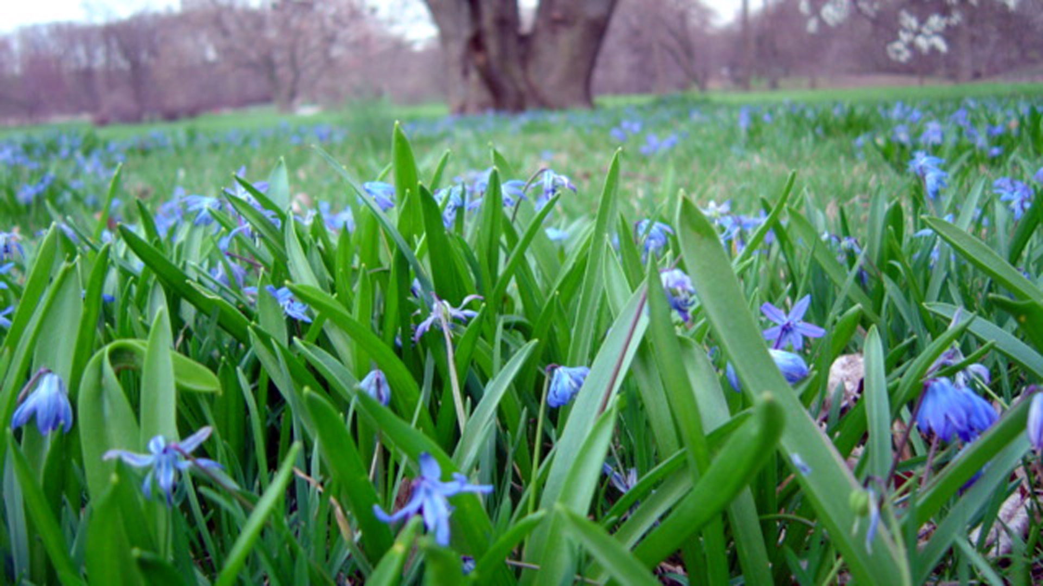
delayedneutron
Notes:
Siberian squill

Slide 22
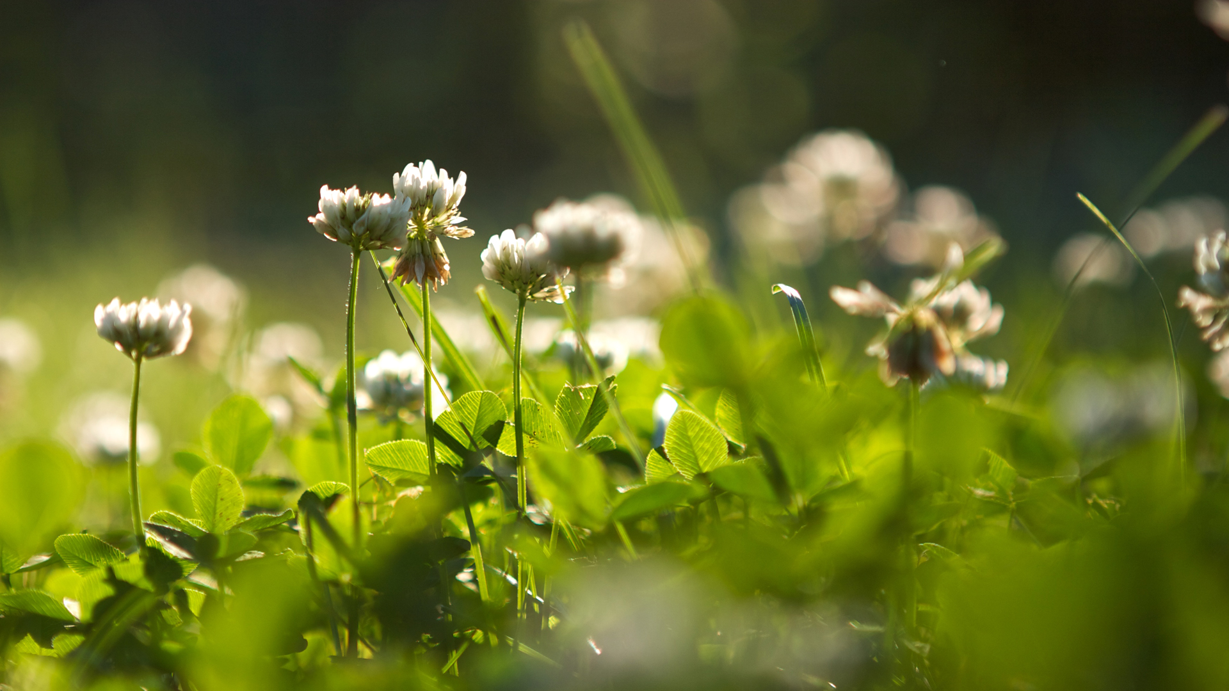
Clover
Chiot’s Run

Slide 23
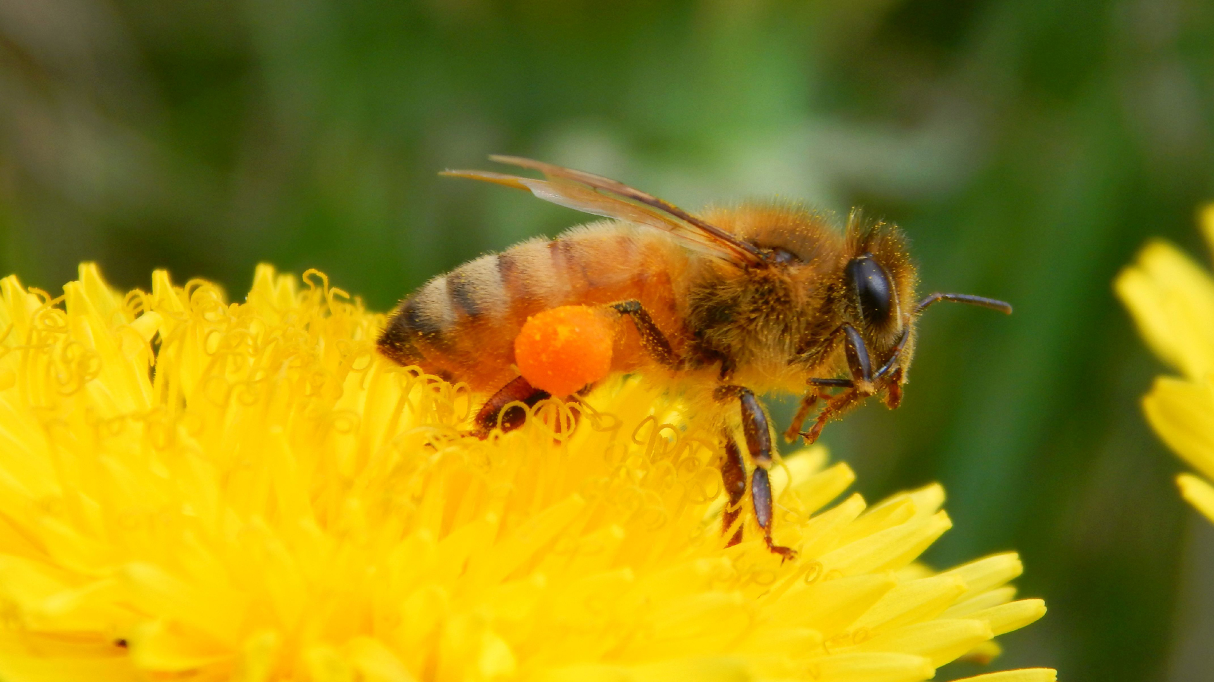
Todd Petit
Notes:
Lawns with dandelions are more friendly to pollinators.

Slide 24

Arturo Satillo
Notes:
Dandelions add beauty.

Slide 25
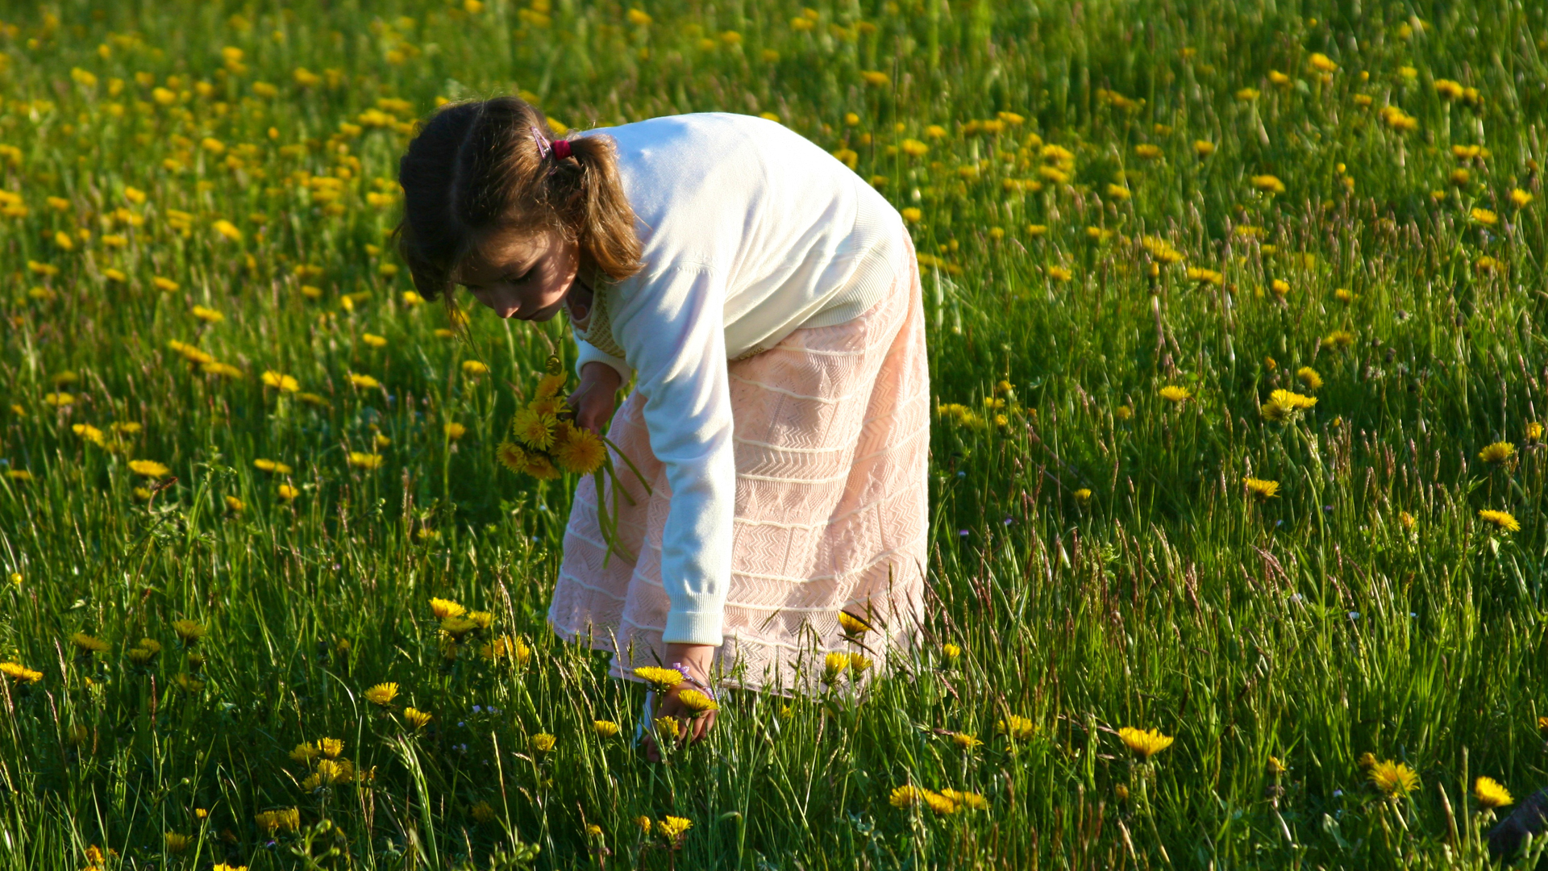
Thomas Guignard
Notes:
Why did we like dandelions when we were kids? Why do we hate dandelions as adults?

Slide 26
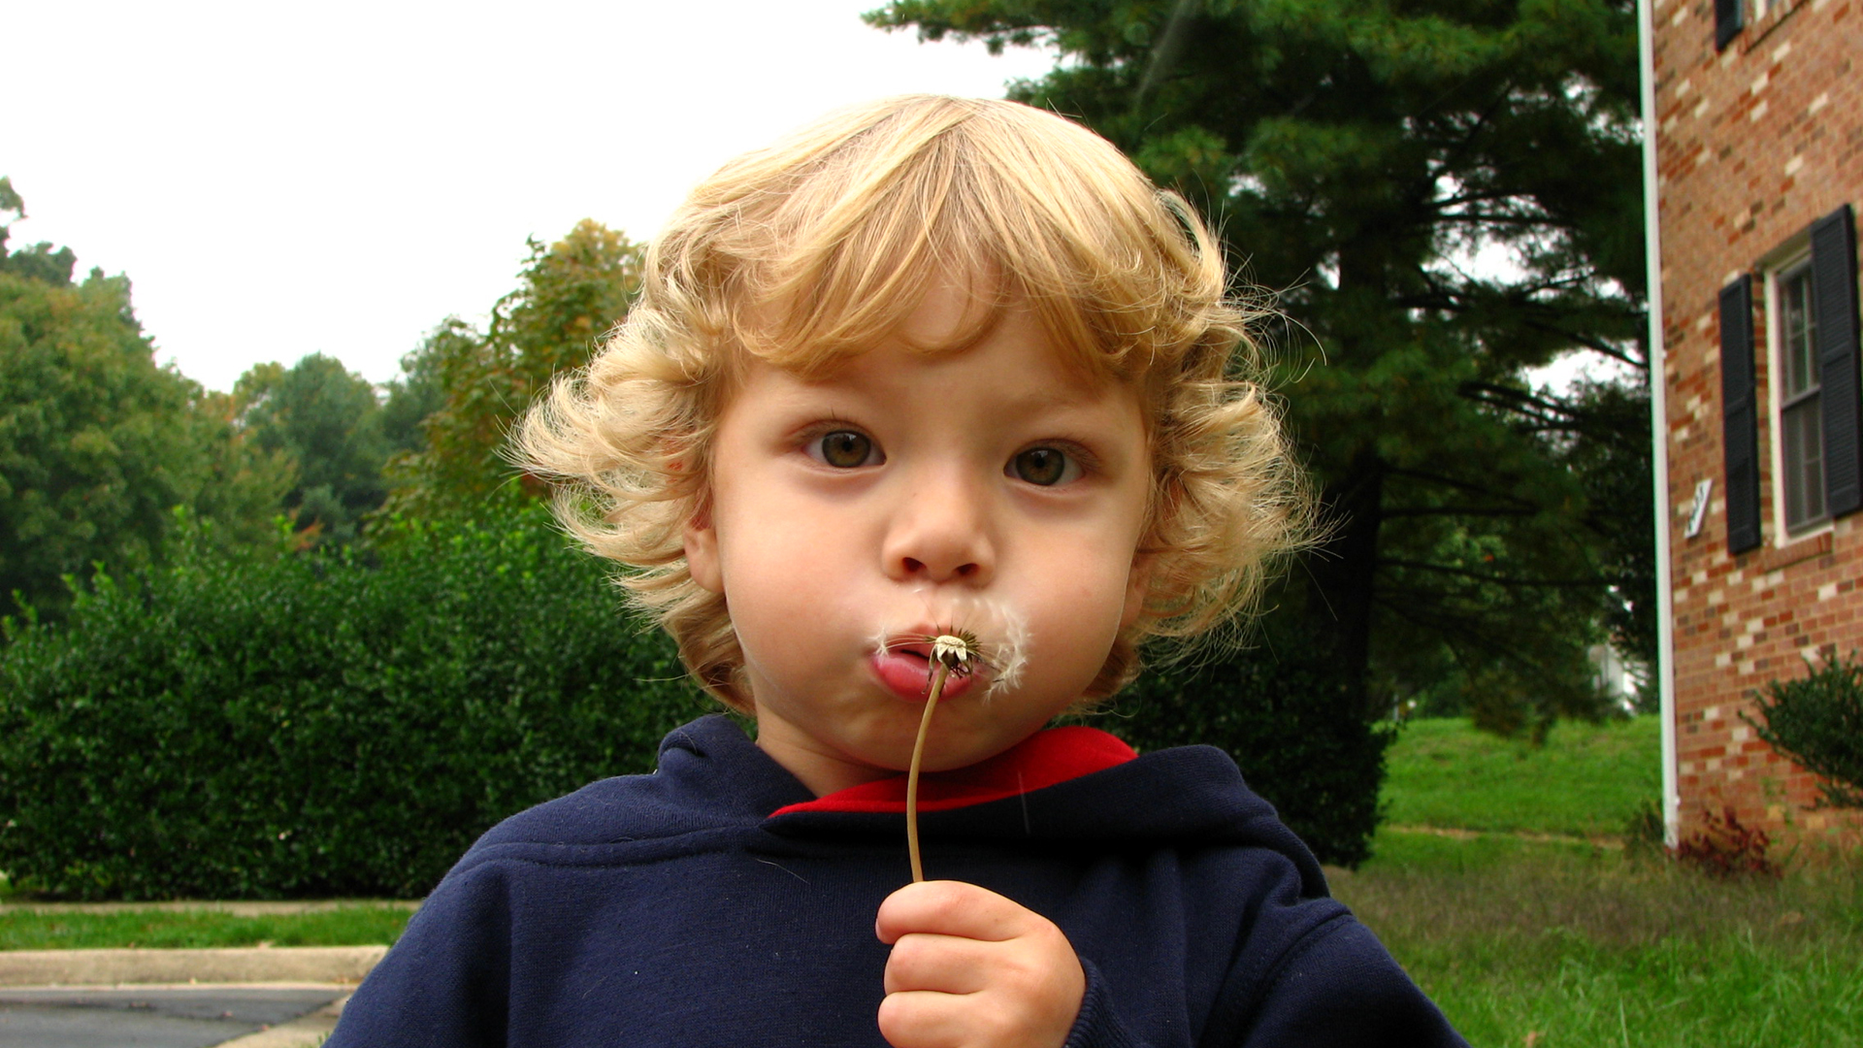
Horizontal.integration
Notes:
Dandelions are fun.

Slide 27

Pexels

Slide 28
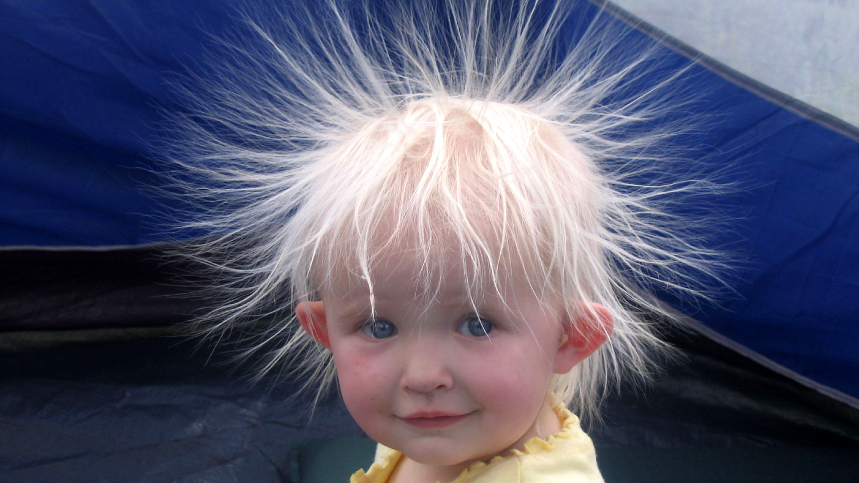
Meer
Notes:
Some kids even like to look like dandelions.

Slide 29
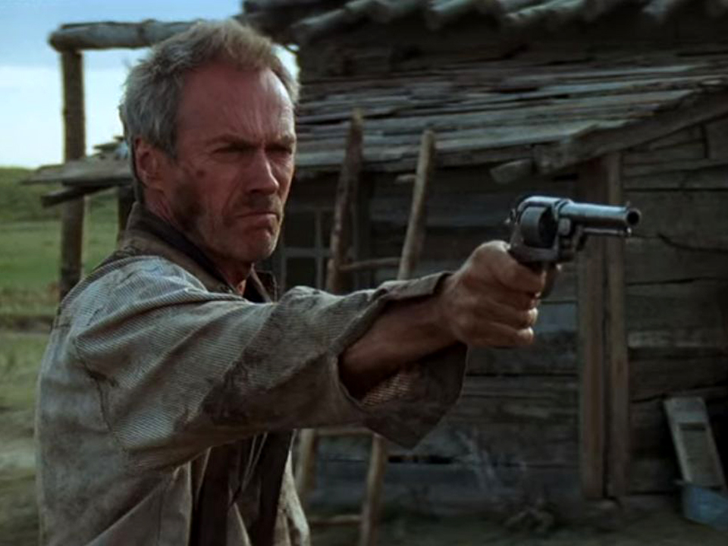
Notes:
Perhaps your approach to gardening is the “Dirty Harry – Make My Day – Take No Prisoners” approach.
CLICK ANIMATION
The most popular vegetable insecticide is carbaryl (Sevin). This powerful insecticide will kill pests on contact – you can even watch the cabbageworms drop off the plants and go into spasms before dying. Revenge is sweet! This is a powerful weapon, but is also toxic. Use with caution and follow the label.

Slide 30


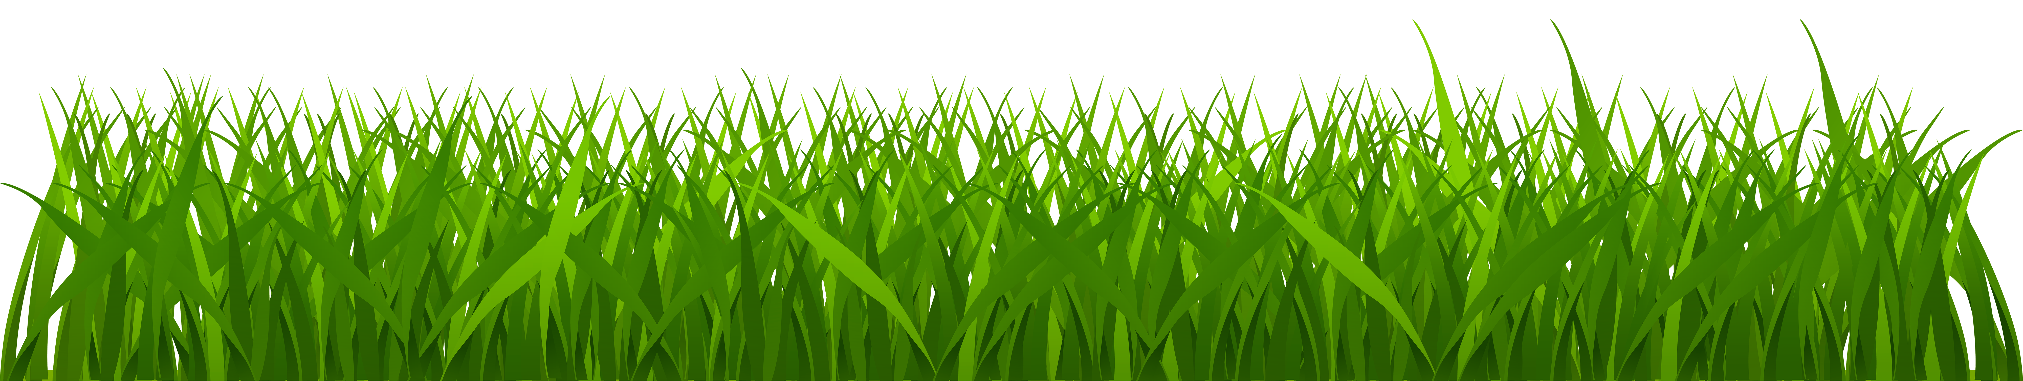

Late Spring/Summer: Poor Control
Notes:
Keep in mind that nutrients mainly move upward, promoting new growth from late spring through summer. It is hard to move herbicide down into its roots at this time.

Slide 31
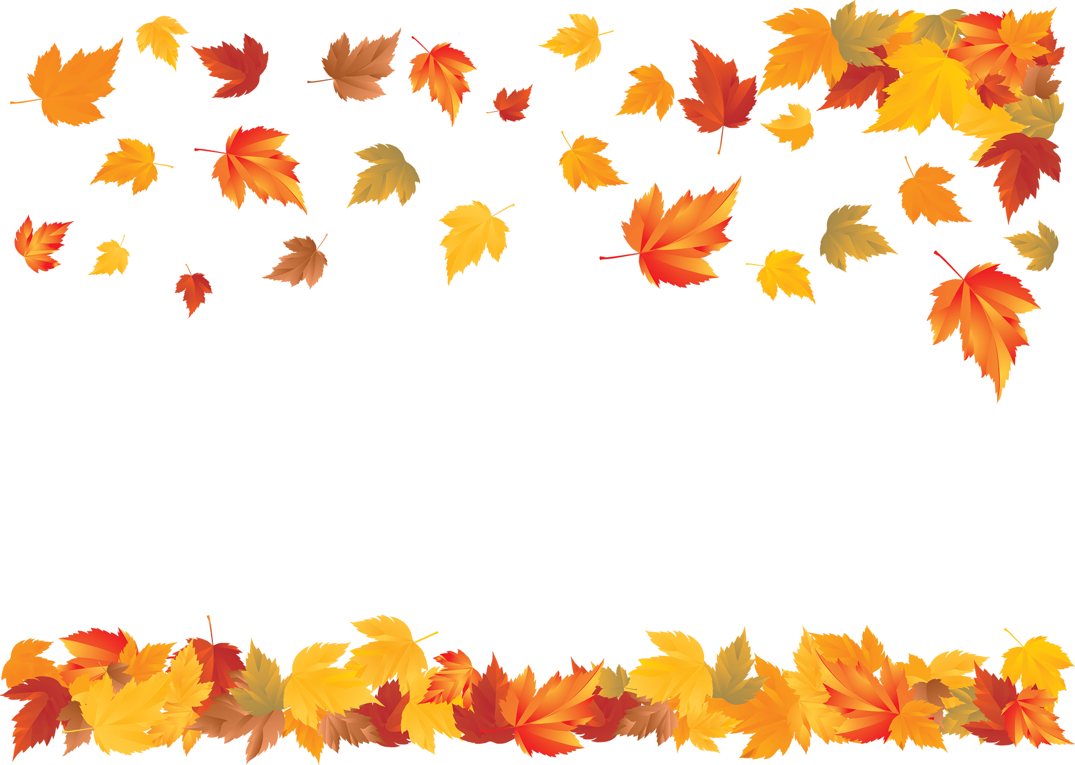
Fall
Notes:
Everything changes in fall. Perennial weeds sense the cold temps and long nights. They start sending their nutrients down into their roots to prepare for winter.
If we spray in fall, the weeds will naturally channel the herbicide down into their roots along with their nutrients. Getting the herbicide down into the root system is the key to success.
That’s why if you spray one time a year, it should be in fall (mid-September).

Slide 32
Death!
Notes:
Everything changes in fall. Perennial weeds sense the cold temps and long nights. They start sending their nutrients down into their roots to prepare for winter.
If we spray in fall, the weeds will naturally channel the herbicide down into their roots along with their nutrients. Getting the herbicide down into the root system is the key to success.
That’s why if you spray one time a year, it should be in fall (mid-September).

Slide 33
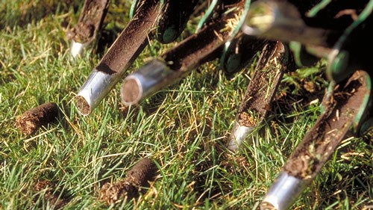
Aerating
Zone8 Landscaping & Lawn Care

Slide 34
How to Save Money?
Fertilize and kill weeds in fall
Don’t collect clippings
Mow tall
Irrigate infrequently/deeply or not at all
Aerate only when needed

Slide 36
Photo Credits
This presentation is provided freely and for information purposes only. Photos used in this presentation are available under Creative Commons licenses specified by the photographer, all allowing for adaptation, modification or building upon. Most photos were downloaded from www.flickr.com or Pixabay and attribution to the photographer is on the photo in this presentation. Photographers include AgentAkit, R. Ella, graham, Tom Kalb, Michael McGimpsey, Jeff Youngstrom, Aki Mykkänen, Internet Archive Book Image, Tim, delayedneutron, Chiot’s Run, Todd Petit, Arturo Satillo, Thomas Guignard, Horizontal.integration, Pexels, Meer, and Zone8 Landscaping & Lawn Care.
Please contact Tom Kalb for specific URLs of photos.

